Slide 1


Slide 2
SMART LICENCE
M FUZAIL RAZA (39091)
M WAQAS ZAFAR (38605)

Slide 3
Introduction
Overview: Revolutionizing the driving license process with Smart License for enhanced efficiency and user experience in our connected world. The Smart License project aims to transform the conventional driving license process. By integrating modern technologies, it enhances efficiency and user-friendliness, providing a seamless experience for our local community.

Slide 4
KEY FEATURES
USER REGISTRATION
Testing - Module
License Issuance:
Streamlined process with a unique learner or test slip.
Computer-based and practical driving tests for a comprehensive evaluation.
Learner's and permanent licenses with digital notifications and optional home delivery.

Slide 5
Admin & User Login
Administrative Interface
Dual Dashboards: Admin login for admin portal, managing users, questions, users(system operator), update user, delete users and license approvals etc.
In the user panel we have add user, symbol test, test result, print license etc.

Slide 6
Technologies Used:
Programming Language: Java
Database: MongoDB
User Interface: JavaFX
Software: Intellij
SMS API: Infobip

Slide 7
Project Workflow
User Registration: Obtain a unique learner for a streamlined process.
Testing Phases: Computer-based and practical driving tests for a comprehensive evaluation.
License Issuance: Receive a learner's license and progress to a permanent license.
Administrative Interface: System operators manage users, questions, and approvals.
Digital Notifications: Stay informed about application status and results on SMS and Whatsapp

Slide 8
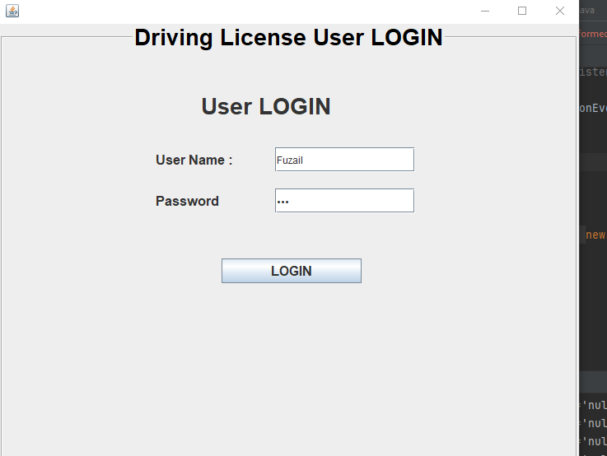
Flow of project:
Admin and User(system operator) Login form:

Slide 9
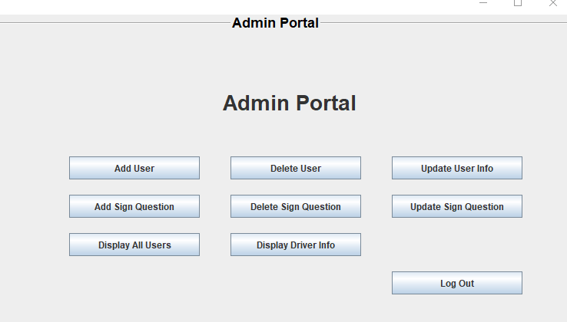
Admin Portal
The AdminPanel class is part of a Java Swing-based driving license issuer project. It features an intuitive graphical user interface for administrative tasks such as updating user information, adding and deleting users, managing sign-related questions, and displaying user and driver information.

Slide 10
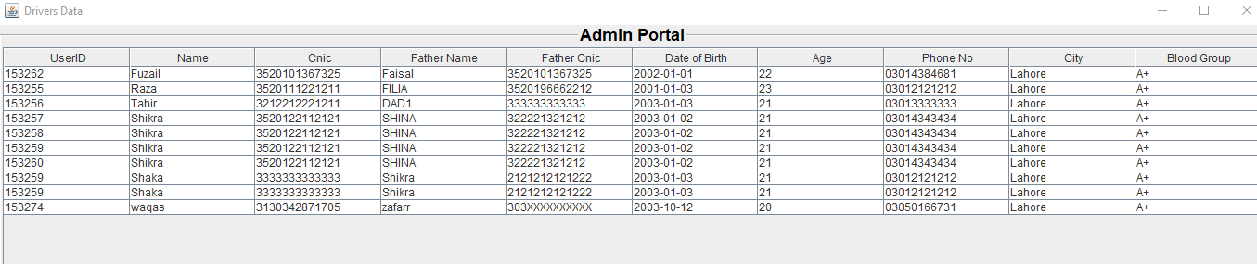
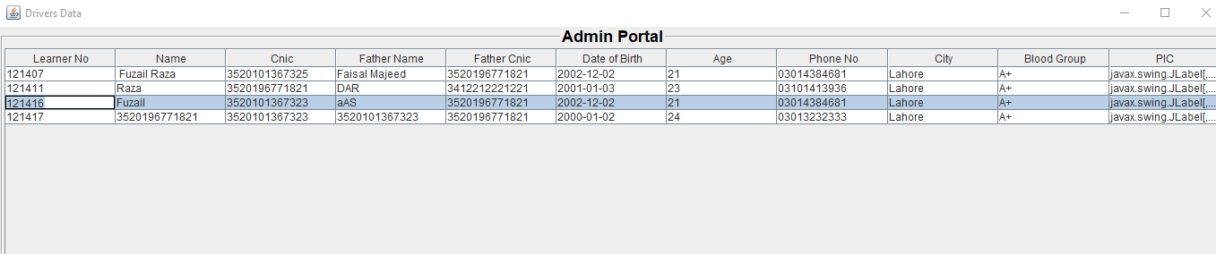
USER & DRIVERS INFO DISPLAY
The AdminPanel class incorporates functionality to display both user and driver information. Through the "Display All Users" and "Display Driver Info" buttons, administrators can access a comprehensive view of user details and driver information, respectively.

Slide 11
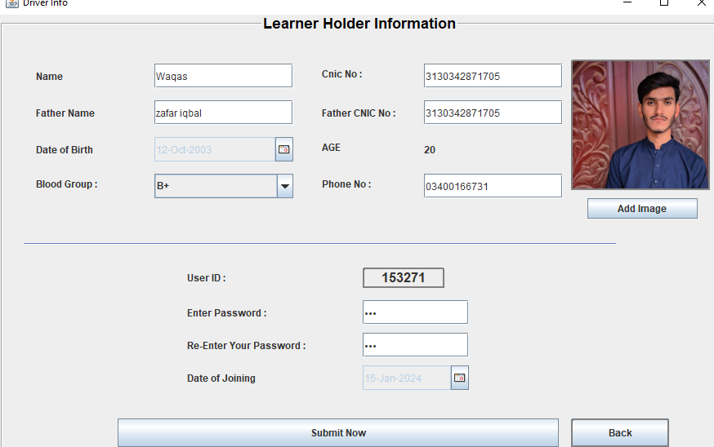
ADD USER (OPERATOR) Form
The AdminPanel class includes an "Add User" button that triggers the creation of a new user (operator) through the Users class. This feature enables administrators to efficiently add operators to the system.

Slide 12
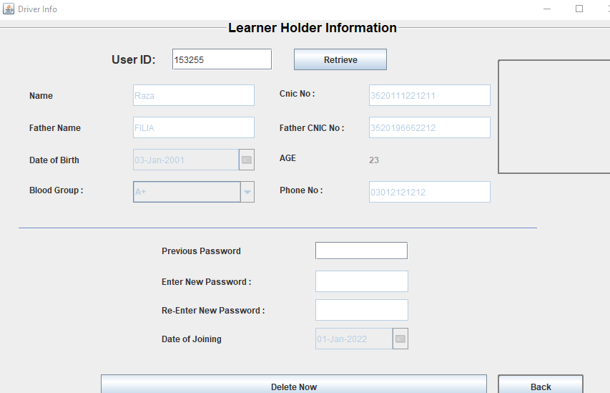
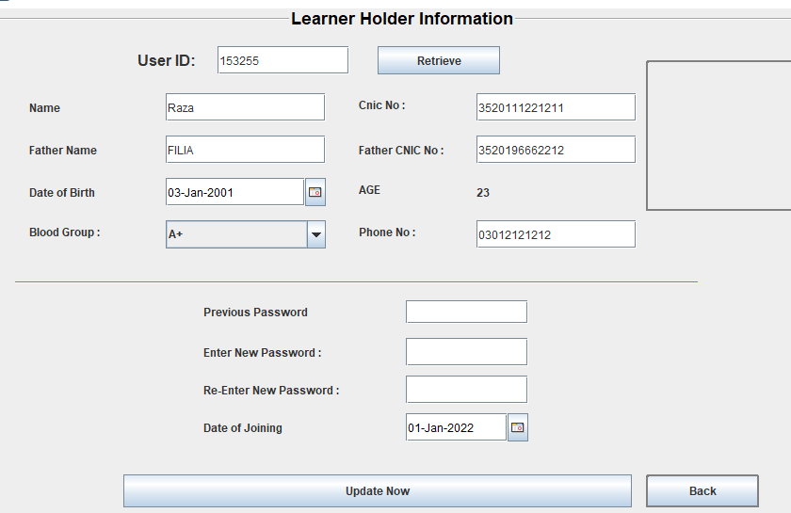
UPDATE & DELETE USER

Slide 13
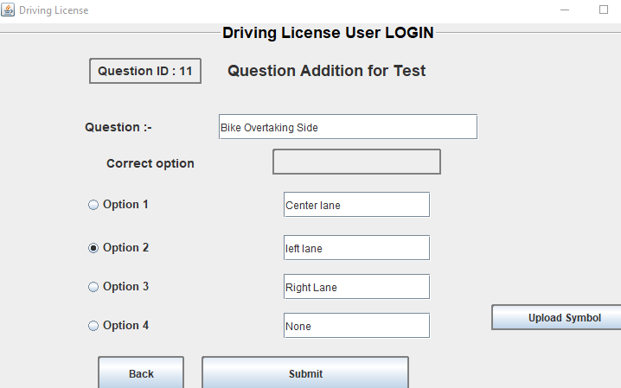
ADD NEW QUESTIONS IN TEST
The AdminPanel class includes functionality for adding new questions to the driving license test through the "Add Sign Question" button. This feature allows administrators to seamlessly expand and update the test question database

Slide 14
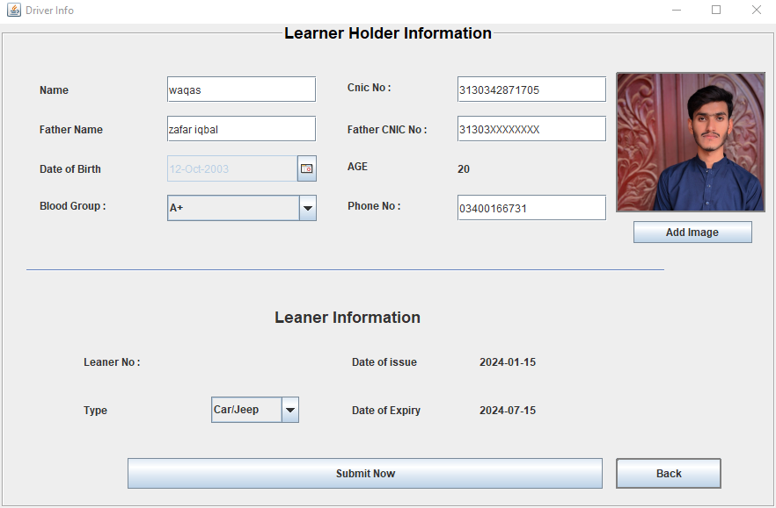
APPLY FOR LEARNER
New driver will be asked to fill this form and he will get his learner license

Slide 15
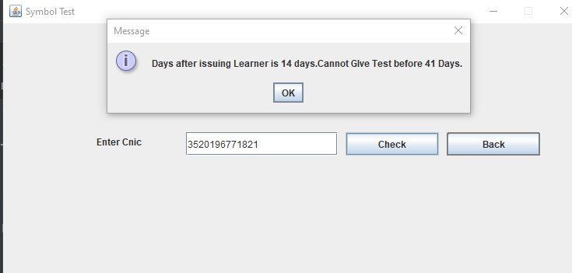
DRIVER COMPUTER TEST
Driver will give the symbol test for further move on, he will enter the cnic to start the test

Slide 16
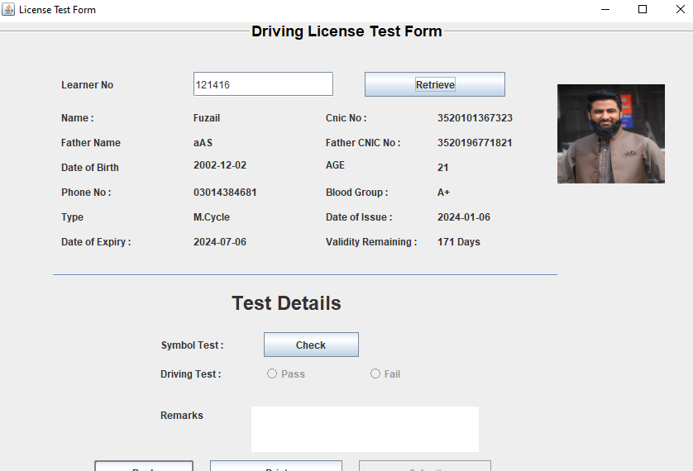
Test Results Form & Test Form:

Slide 17
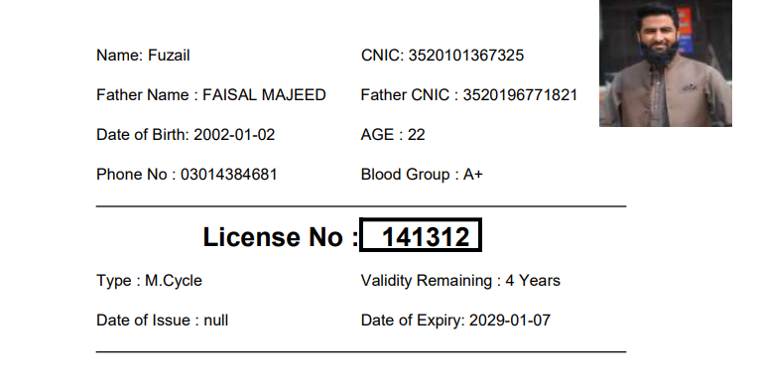
Final License
This is the final output of driver license

Slide 18
Conclusion
Project Impact: Drive Ease signifies a leap in driving license management, seamlessly blending technology and user-centric design.
Practical Application: Demonstrates the practical implementation of Java programming skills, setting a benchmark for real-world solutions.

Slide 19
THANK YOU

